Slide 1
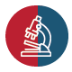
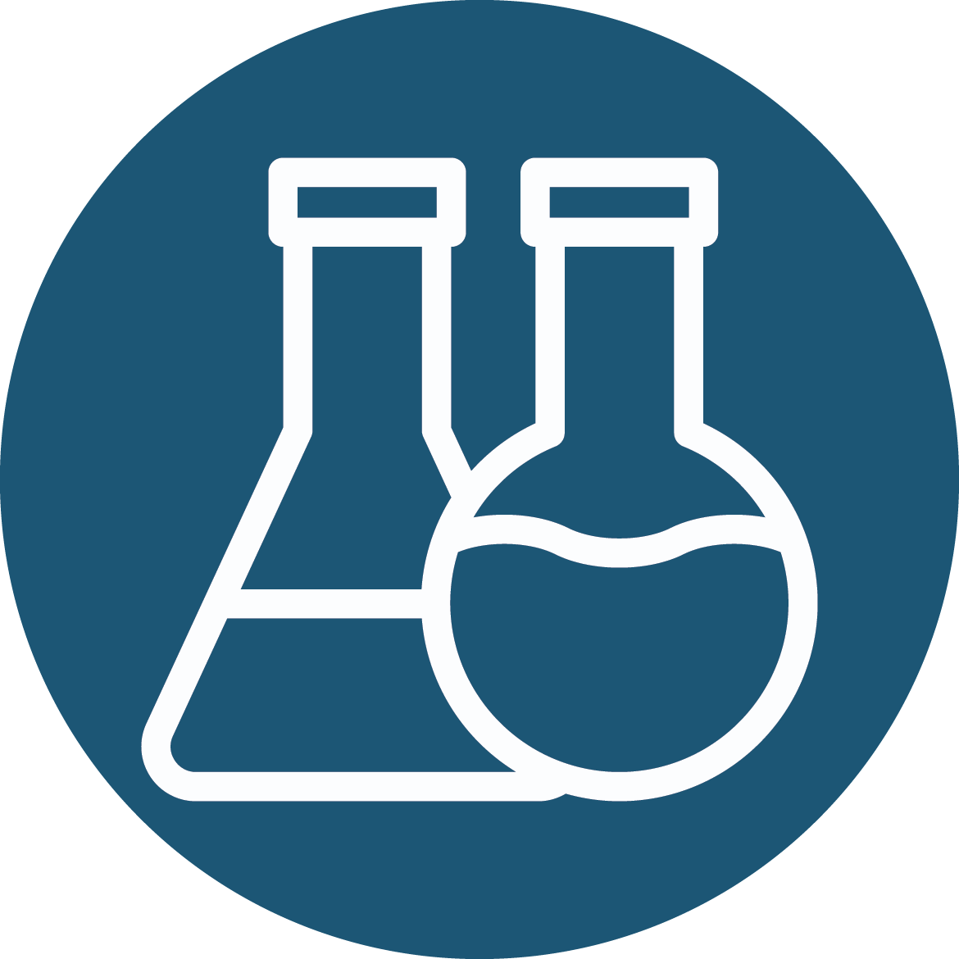
Overview of Thrombosis and Thrombotic Complications
Erika Crouch, M.D., Ph.D.
Professor of Pathology and Immunology

Slide 2
Event Objectives
Subset of LACE Objectives
Describe how thrombus formation differs from thrombosis.
List the major mechanisms of thrombosis: including endothelial injury, altered blood flow, and hypercoagulability.
Compare and contrast the clinical and pathological features of venous and arterial thrombi.
List the possible clinical consequences or complications of thrombosis.
Describe and recognize the gross and microscopic appearances of thrombi and thromboemboli.
Define infarction, describe the differences between "white" and "red" infarcts, and recognize the gross and microscopic appearance of infarcted tissues
Describe the pathogenesis and clinical consequences of pulmonary emboli.
Describe the pathogenesis and clinical findings associated with disseminated intravascular coagulation.

Slide 3
Thrombosis Definition
Thrombosis denotes the clotting of blood in the absence of a breach in the vascular system, i.e., the formation of a thrombus.
Thrombosis is always a pathologic process.

Slide 4
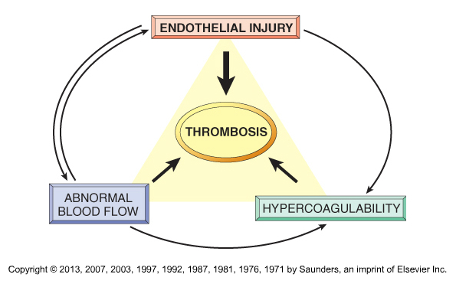
Mechanisms of Thrombosis Virchow Triad
Notes:
Endothelial injury is often described as the major factor, with contributions of abnormal flow and hypercoagulability. However, this may not be true in any specific patient.
Abnormal flow can cause endothelial injury, but endothelial injury can contribute to abnormal flow. Both endothelial injury and abnormal flow can contribute to abnormalities in coagulation.

Slide 5
Endothelial Activation or Injury Numerous etiologies
Atherosclerosis
Surgery or trauma
Infection
Inflammation
Many others

Slide 6
Selected Activities of Activated ECs that Promote Thrombus Formation
Effects on Platelets
Secretion of very large vWF multimers that can be activated under conditions of abnormal flow and permit platelet binding
Procoagulant Effects
Expression of tissue factor (TF)
Downregulation of endogenous anticoagulants, e.g., decreased thrombomodulin with decreased activation of Protein C
Secretion of plasminogen activator inhibitors (PAIs) that inhibit fibrinolysis

Slide 7
Abnormal Blood Flow
Turbulence
Mechanical stress or damage with endothelial activation
Disruption of laminar flow allows platelets to contact ECs
Stasis (decreased blood flow)
Reduces dilution of activated clotting factors
Reduces influx of circulating inhibitors
Notes:
With turbulence, cells within the blood can be forced into abnormal proximity with the endothelial lining. Interestingly, turbulence can also create areas of stasis.

Slide 8
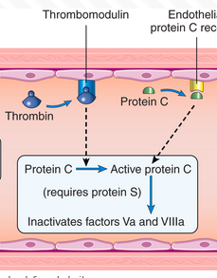
Hypercoagulability*
Primary (inherited, selected examples)
Factor Va Leiden mutation/variant **
The most common inherited cause. Variant sequence prevents cleavage and inactivation of FVa by active Protein C, which allows increased conversion of prothrombin to thrombin.
Prothrombin G20201A mutation/variant
Increased levels of prothrombin secondary to mutation in promoter that results in increased transcription
Secondary (acquired, selected examples) **
Immobilization
Myocardial infarction, atrial fibrillation, or prosthetic valves
Tissue injury (surgery, fracture, burns)
Cancer (Trousseau sign)
Heparin induced thrombocytopenia
Antiphospholipid antibody syndrome
Many other and less common risk factors
Leiden mutation prevents FVa cleavage by Protein C, a potent vitamin K-dependent endogenous anticoagulant
Notes:
* I highly recommend becoming familiar with Table 3.2 – Hypercoagulable States, in Robbins Basic Pathology, 2023. Pay particular attention to the most common primary causes and the secondary causes associated with the highest risk. It expands this important list and will be useful down the road.
** Factor Va is required for conversion of prothrombin to thrombin; the Va point mutation/variant prevents inactivation by active Protein C, an important vitamin K dependent circulating anticoagulant. It is an AD disorder with incomplete penetrance. The variant is found in approx. 5% of the white population and a much higher proportion of patients with deep leg vein thrombosis. Heterozygotes are also at increased risk.

Slide 9
Arterial vs Venous Thrombi
Arterial (high flow):
Associated with turbulence or localized stasis and often not occlusive.
Often involve injured cardiac chambers, damaged cardiac valves, areas of atherosclerosis, or aortic aneurysms.
Venous (low flow):
Usually associated with stasis and usually occlusive.
Often but not always involve deep veins of the lower extremity*
Notes:
* Other potential sites include upper extremities, periprostatic veins, and ovarian or periuterine veins. Other sites can be involved in patients with hypercoagulable states. (dural sinuses of brain, portal or hepatic vein).

Slide 10
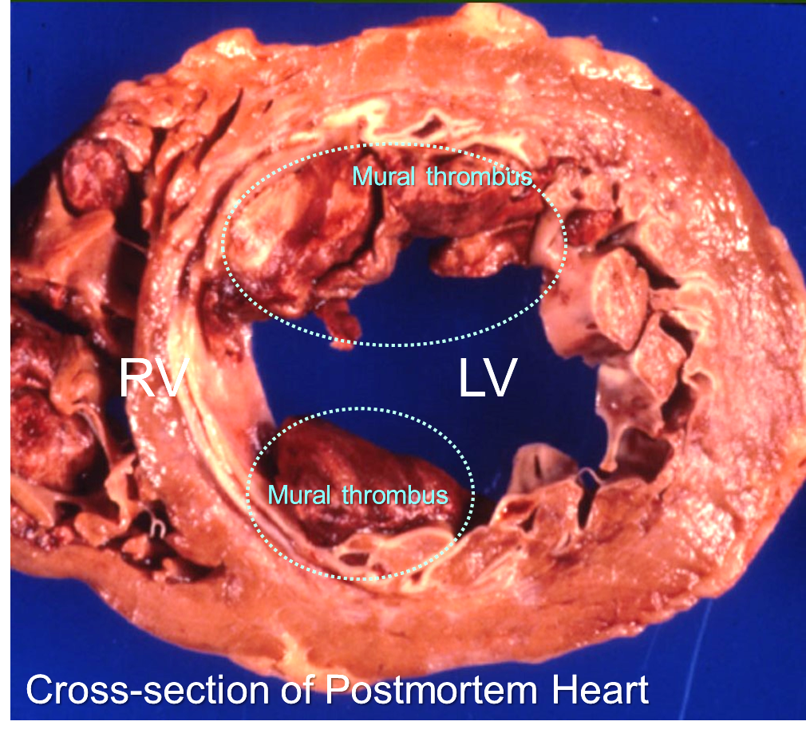
Mural Thrombi
Mural Thrombi of Left Ventricle
Thrombi that are adherent to the wall of a cardiac chamber or vessel
Most are arterial
Usually form in an area of abnormal blood flow
Notes:
The lumen of the left ventricle (LV) is partially occluded by thrombus that is adherent to the ventricular wall (mural thrombus) in areas of past ischemic injury. Mural thrombi can also form in the left atrium as a consequence of stasis occurring in the setting of atrial dilatation or an atrial arrhythmia.

Slide 11
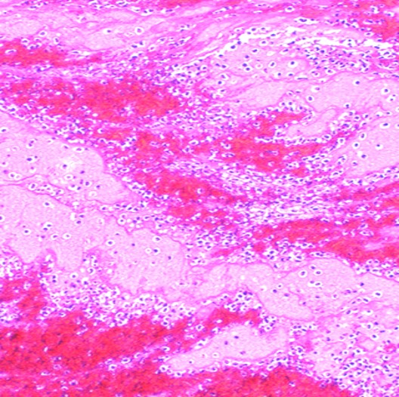
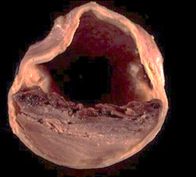
Morphology of Recent Arterial Thrombi
Lines of Zahn *
Arterial thrombi typically show obvious gross and microscopic layering of RBCs, white cells, platelets, and fibrin (Lines of Zahn)
Lamination only occurs in flowing blood (not postmortem or in tube)
Adherent to wall of vessel or chamber
RBCs
Gross
Platelets & Fibrin
H&E of Thrombus
Notes:
* The inset shows gross image of a mural thrombus in a vessel. The pale striations are Lines of Zahn. The characteristic layering is further illustrated in the micrograph. The light and dark lamination reflects differences in the distribution or layering of erythrocytes, platelets, fibrin, and white blood cells. The layering provides evidence that the occlusion is a premortem thrombus, rather than a postmortem blood clot. Although most obvious in arterial thrombi, they can sometimes be seen in venous thrombi.
Arterial thrombi are usually platelet rich, because they often occur at sites of vascular injury. Venous thrombi are often described as “red” because they tend to be erythrocyte rich and platelet poor. Arterial thrombi also tend to be more strongly adherent to the vessel or chamber because they are more likely to initiate at sites of endothelial injury. However venous thrombi can also become adherent; in this case, endothelial injury may result from thrombosis and abnormal flow
Arterial and venous can propagate or extend within the lumen away from the site of initiation. Both types propagate in the direction of blood flow; however, arterial thrombi propagate toward the capillary bed, while venous thrombi propagate toward the heart.

Slide 12
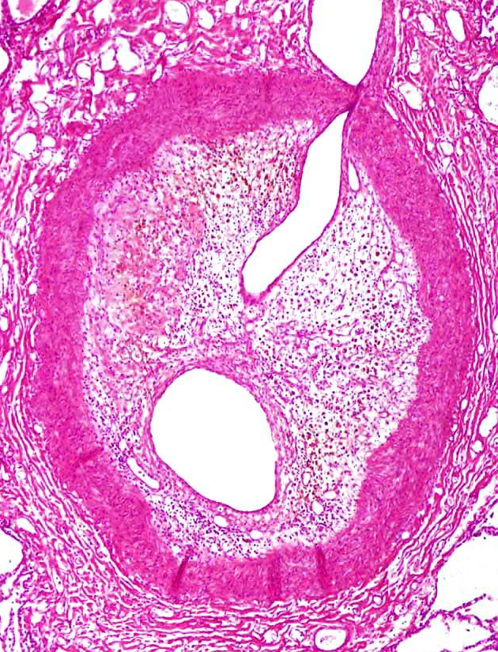
Potential Fates of Thrombi
Propagation by accrual of more red cells and platelets
Dissolution via fibrinolysis
Detachment and embolization to a downstream site
Recanalized
thrombus
Organization (i.e., ingrowth of endothelial and connective tissue cells) sometimes with recanalization forming one or more new lumens
New lumen
Media
Lung
H&E of organized and recanalized
thrombus in a pulmonary artery
Notes:
The histological section shows a pulmonary artery with almost complete occlusion of the lumen by organized thrombus that has undergone partial recanalization, i.e. organization of the thrombus with formation of new vascular lumens. It is indicative of a thromboembolic event in the relatively remote past.
Propagation of venous system thrombi is toward the heart, while propagation of arterial thrombi is away from the heart. In other words they propagate in the direction of blood flow.

Slide 13
Purposeful Review of Endogenous Fibrinolysis and Thrombolysis
Tissue plasminogen activator (tPA), a serine protease, considered essential for the dissolution intravascular thrombi
Synthesized by ECs and acts intravascularly
Mechanism
Plasminogen is secreted by the liver and binds to fibrin clots
tPA attaches to fibrin on the clot via its fibronectin and EGFR domains.
It activates fibrin-bound plasminogen and generates plasmin
Plasmin cleaves fibrin with dissolution of clot
Notes:
Mice deficient in tPA show decreased efficiency of pulmonary clot lysis and increased frequency of endotoxin induced venous thrombosis.

Slide 14
Review of Fibrinolytic System
For Future Information
Molecule | Other Names | Type | Synthesis | Roles
Plasmin |  | Serine protease | Liver as plasminogen | Plasminogen binds to fibrin in fibrin clots, which increases its susceptibility to TPA and other plasminogen activators. Plasmin promotes fibrinolysis but plays many biological functions. It is inactivated by α2 macroglobulin and α2-antiplasmin.
Tissue plasminogen activator | tPA or TPA | Serine protease | Endothelial cells | Promotes fibrinolysis by converting fibrin bound plasminogen to plasmin. Recombinant forms are used clinically to disrupt clots. Inhibited by PAIs. There are other plasminogen activators, e.g., urokinase (uPA).
Factor XIIa | Hageman factor | Serine protease | Liver | Can generate plasmin from plasminogen*
Plasminogen activator inhibitors | PAI | SERPIN – protease inhibitor | Activated endothelial cells | Inhibits fibrinolysis by inhibiting plasminogen activator, i.e., a procoagulant effect
Thrombin Activatable Fibrinolysis Inhibitor | TAFI, Carboxypeptidase B2 | Carboxy-peptidase | Liver | Inhibits fibrinolysis. TAFI removes C-terminal binding sites on fibrin for tPA and plasminogen, decreasing the ability of fibrin to stimulate fibrinolysis. Elevated levels of TAFI have been associated with an increased risk of venous thrombosis. Thrombin activation is mediated by TM/thrombin complex
Notes:
* There is a high degree of homology between the proteins of the intrinsic contact system of coagulation and those of the fibrinolytic system. FXII is homologous to tissue plasminogen activator (tPA) and the two main substrates of FXIIa, prekallikrein and FXI, are homologous to plasminogen. FXIIa, FXIa and kallikrein can convert plasminogen to plasmin, however, at a lower rate than tPA and urokinase plasminogen activator (uPA)
The kringle domain is a highly conserved protein structure found in plasminogen, tissue plasminogen activator, urokinase and Factor XII, as well as prothrombin. Kringle domains broadly participate in various protein-protein interactions. Plasminogen binds to fibrin via its kringle domains

Slide 15
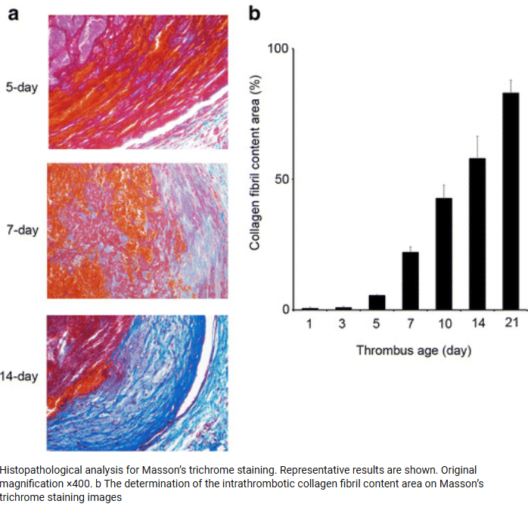
Organizing Thrombus Collagen Accumulation in Murine Model
Migration of ECs and fibroblasts into thrombus from injured vessel wall
Luminal deposition of connective tissue and eventual complete lysis of thrombus
Variable recanalization
https://www.researchgate.net/publication/309275384_Immunohistochemical_detection_of_intrathrombotic_fibrocytes_and_its_application_to_thrombus_age_estimation_in_murine_deep_vein_thrombosis_model
Notes:
Organization refers to a proliferation of connective tissue cells in response to tissue damage, e.g., organizing thrombus, organizing pneumonia, organizing pericardial effusion.

Slide 16
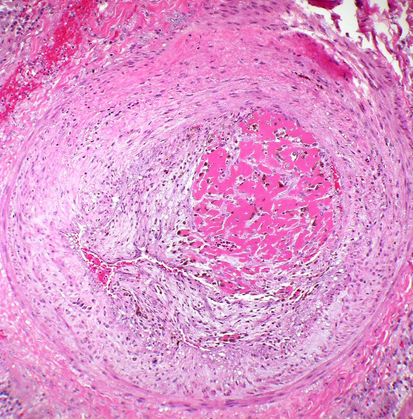
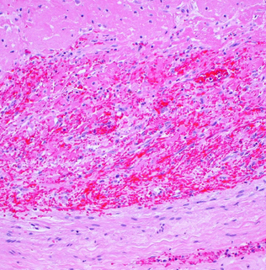
Organizing Thrombus
Fibrin
Fibrin
Early organization near vessel wall
Luminal CT
Vessel wall
H&E of organizing thrombus
H&E of organizing thrombus with infiltrating
spindle cells (FBs and ECs)

Slide 17


Slide 18
Complications of Thrombosis
Embolization of thrombus to distant sites via arteries or veins as a “thrombo-embolus”
Obstruction of blood flow near site of origin
Consumptive coagulopathy (disseminated intravascular coagulation, DIC)
All can result in areas of ischemia with tissue death, i.e., infarction

Slide 19
Pulmonary Thromboemboli
Pulmonary emboli: most common preventable cause of death in hospital setting
Most (> 95%) arise from deep leg veins
Most are small and clinically silent
Sudden cardiac failure if >60% blockage, e.g. by “saddle embolus”
Not all emboli are thromboemboli
More in Robbins and Module 3
Notes:
A “saddle embolus” is an embolus that occludes the left and right main pulmonary arteries.

Slide 20
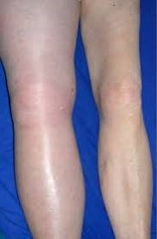
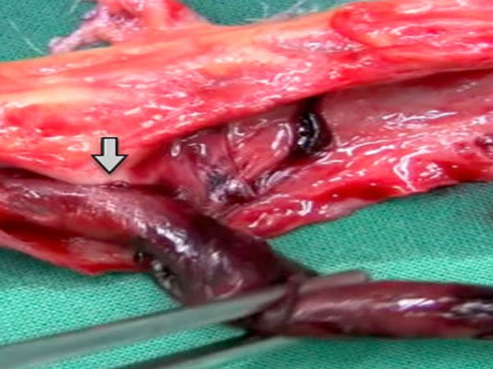
Venous Thrombosis
Excised Leg Vein
Swollen leg with DVT
Normal
Adherent
Vein lumen
Thrombus
Clinical Photo
Gross Photo
Notes:
Most pulmonary emboli arise in the deep leg veins as a consequence of deep venous thrombosis (DVT). The local effects of the thrombus can include swelling of the affected extremity (left). The image at right shows a thrombus adherent to the wall of an involved deep leg vein.

Slide 21
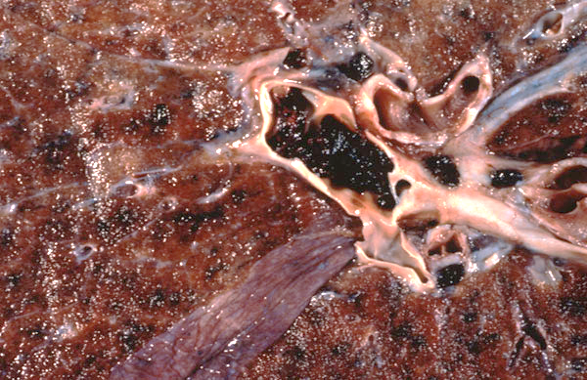
Pulmonary Embolus (PE)
Normal Lung
PE
PA
Gross
Notes:
A pulmonary artery (PA) occluded by a pulmonary embolus (PE). The coiled or “worm like” appearance of the thrombus reflects the fact that is was formed in peripheral veins and subsequently embolized (traveled) to the lungs.

Slide 22
Contribute to three major causes of mortality and morbidity :
Thrombosis & Infarction
Myocardial infarction
Cerebrovascular accident
Pulmonary embolism
All 3 are associated with ischemic injury and necrosis secondary to thrombotic or thrombo-embolic obstruction of the vascular supply.

Slide 23
Factors that Increase the Risk of Infarction
Intrinsic vulnerability of the tissue to ischemia, e.g., heart, brain
Tissues with terminal arteries, which lack of alternative or collateral sources of perfusion
Rapid development of vascular occlusion with insufficient time to develop collateral circulation.
Pre-existing hypoxemia can sometimes increase the risk and extent of infarction

Slide 24
“Red Infarcts”
Loose (non-solid) tissues where blood can collect and/or tissues with dual vascular supplies, e.g., lung
Venous occlusion, e.g., torsion or twisting of vessels draining an organ
Reperfusion after infarction, e.g., following thrombolysis

Slide 25
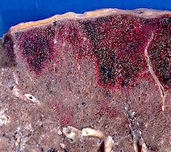
Pulmonary Infarcts Example of a “Red Infarct”
Pleural surface
Hemorrhagic
infarcts
Normal
Gross
Notes:
The gross of lung shows pleural based and roughly wedge shaped or confluent areas of hemorrhage as the result of small embolic arterial occlusions. Image from Wikipedia

Slide 26
“White Infarcts”
Arterial occlusion with no blood flow distal to obstruction
Most common in solid organs that limit extravasation of blood
Usually seen in organs with end-arterial circulations (lack arterial anastomoses), such as the spleen and kidneys; often “wedge shaped”

Slide 27
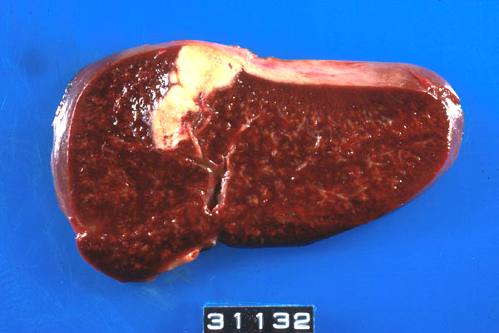
Splenic Infarct Purposeful Repetition
Capsule
Normal parenchyma
Gross
Notes:
Splenic infarct (wedge-shaped area of coagulative necrosis) secondary to thrombosis of splenic artery.

Slide 28
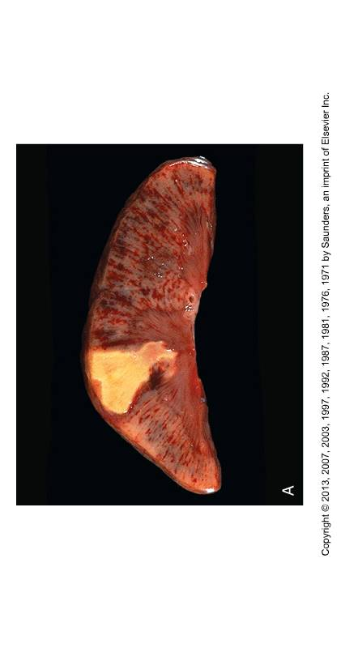
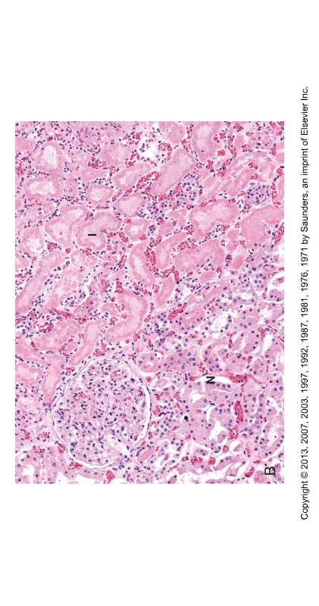
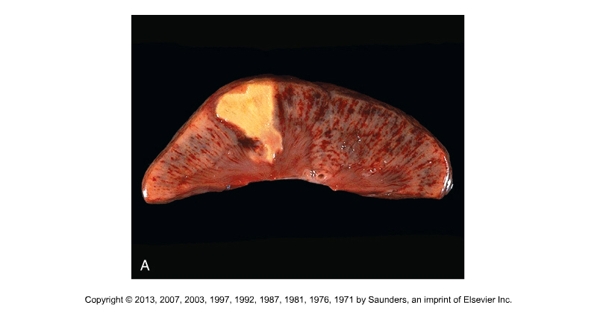
Renal Cortical Infarct
Infarct
Normal parenchyma
Capsular
surface
Normal
Gross of Kidney
H&E

Slide 29
Pathology of Infarcts
Remember: usual microscopic pattern is coagulative necrosis involving all compartments of the involved tissue; exception is the brain, which shows liquefactive necrosis
“Red infarcts” have associated hemorrhage
“White infarcts” are white or pale, but may show hyperemia, hemorrhage, and/or inflammation at margins
“Septic infarcts” show associated acute inflammatory cells and/or bacteria. Can form locally or result from embolization of thrombi (septic emboli) from infected tissues.

Slide 31
Disseminated Intravascular Coagulation (DIC)
An acquired syndrome characterized by the systemic intravascular activation of blood coagulation with the formation of thrombi in many organs.
Disseminated coagulation is associated with consumption of platelets and clotting factors, i.e., a consumptive coagulopathy, that can lead to bleeding at various sites.

Slide 32
Potential Causes of DIC
Massive tissue injury of any cause (trauma, burns, extensive surgery)
Obstetrical complications (e.g., septic abortion, amniotic fluid embolism, toxemia)
Systemic infections (sepsis) of many types
Specific cancers
Certain toxic exposures
Many other causes
The common denominator is extensive endothelial injury. No need to memorize the list for Module 2.

Slide 33
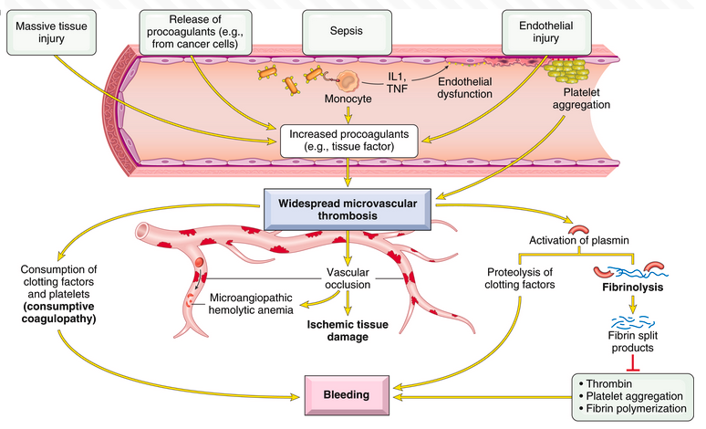
Pathogenesis of DIC and Complications
Robbin’s Basic Pathology, 2023 – Fig. 10.30

Slide 34
Pathogenesis of DIC & Complications
Sepsis
Extensive tissue damage
Endothelial Injury
Exposure of TF and release of inflammatory cytokines
Platelet Activation and Aggregation
Widespread Microvascular Thrombosis
Activation of Plasmin
Hemolytic Anemia
Vascular Occlusion
Fibrinolysis
Ischemic Tissue Damage
Consumption of Clotting Factors & Platelets
Fibrin degradation products*
Proteolysis of clotting factors
Bleeding
Multi-organ System Failure
Only definitive treatment is to remove the cause
Notes:
This complex slide has a build.
Bacterial endotoxins are common causes of DIC in the setting of systemic infection or sepsis. These can stimulate the release of tissue factor and inflammatory cytokines, such as TNFalpha and IL-1, and decrease the expression of thrombomodulin. In some situations, procoagulant substances other than tissue factor may be released. This occurs with certain obstetrical complications and with some cancers. Certain cancers can also release proteases that cause endothelial damage.
* Fibrin degradation products can interfere with platelet functions and reportedly thrombin activity, at least in vitro, and provide clinical markers of fibrinolysis.

Slide 35
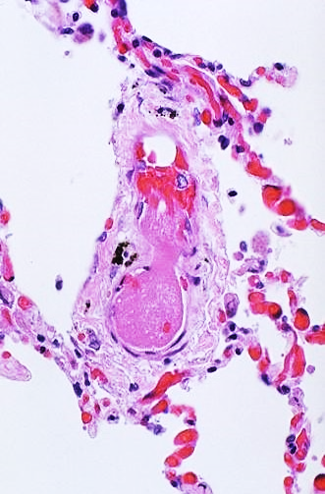
Pathology of DIC
Fibrin- and platelet-rich microthrombi in arterioles and capillaries of many organs, sometimes with associated infarction
Petechiae and ecchymoses involving skin and serosal or mesothelial surfaces
Larger than expected hemorrhage in areas of infarction
Resulting “microangiopathic” hemolytic anemia *
Airspace
Microthrombus
in small vessel
Airspace
H&E
Lung of patient with DIC
Notes:
* As blood cells traverse injured capillaries containing microthrombi, they become fragmented, resulting in “microangiopathic” hemolytic anemia. The damaged cells can be observed on blood smears as “schistocytes”

Slide 36
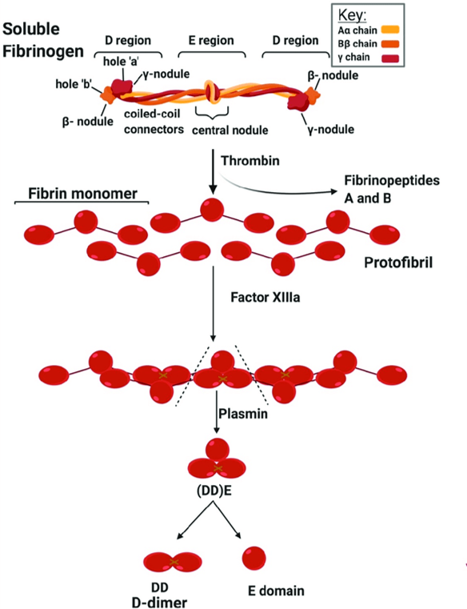
Fibrinolysis and D-dimers*
D-dimers are plasmin-mediated degradation products of Factor XIII crosslinked fibrin**
Assays are sensitive but not specific with respect to etiology (many potential causes for a positive test)*
Negative results rule against DVT, PE, or stroke. High levels strongly suggest a thrombotic state, but do not suggest a cause. Additional clinical correlation is always required.
E
D
D
Cross-linked fibrin
Molecular structures for future information
Notes:
* Fibrinogen molecules are crosslinked hexamers (pairs of 3 chains).
**Thrombin releases N-terminal fibrinopeptides from the E domain, which allows the molecule to disassemble to form fibrin monomers that are crosslinked by Factor XIIIa. Plasmin cleavage of crosslinked fibrin releases fibrin split products that include crosslinked D-dimers. The D domains binding sites for platelet GPVI and GpIIb/IIIa.
Fibrinolysis usually pronounced: fai·bruh·naa·luh·suhs

Slide 37
Laboratory Findings in DIC For Future Information
Test | Findings | Mechanisms
PT | May be preferentially increased early in course | Early depletion of FVII secondary to tissue injury
aPTT | Increased later the course | Thrombosis with consumption of clotting factors
Platelets | Decreased (thrombocytopenia) | Consumption of platelets
Fibrinogen | Decreased late in course | Widespread thrombosis but decreases may be partially offset by acute phase response
D-dimer | Increased | Extensive fibrinolysis
Hematocrit | Decreased | Bleeding secondary to consumptive coagulopathy. Microangiopathic damage to RBCs

Slide 38
Thrombotic Microangiopathies (TMAs)
Acquired or inherited disorders characterized by microvascular thrombosis with resulting low platelets (thrombocytopenia), damaged RBCs, and sometimes renal failure (Module 4).
Unlike DIC, TMs are primarily disorders of platelet activation with formation of platelet-rich thrombi in various tissues.
Activation of the coagulation cascade is not or primary importance.
Not testable content for Module 2 but you will encounter it in Module 4
Notes:
* TTP results from inherited deficiency or acquired autoantibodies to ADAMTS13 (a disintegrin and metalloproteinase with a thrombospondin type 1 motif, member 13), also known as von Willebrand factor-cleaving protease (VWFCP)
TMAs also include Hemolytic-uremia syndrome (HUS) and complement-mediated TMA resulting from inherited or acquired dysregulation of the alternative pathway of complement.

Slide 39
Thrombotic Thrombocytopenic Purpura (TTP) For Future Information
Signs and symptoms of a TM but usually associated with neurological deficits and renal insufficiency.
Associated with acquired or inherited deficiency of ADAMTS13, which limits the enzymatic inactivation of vWF multimers and leads to widespread platelet activation and aggregation.
Acquired deficiency results from autoantibodies.
Often precipitated or complicated by toxin-mediated endothelial injury

Slide 40
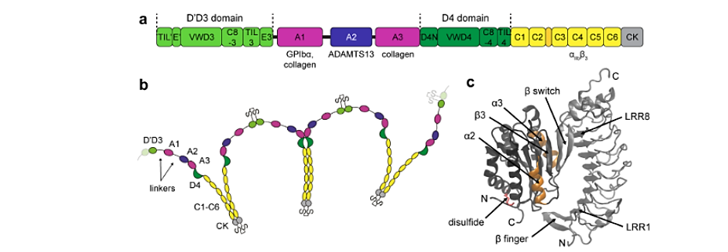
ADAMTS13 Regulates Multimer Size Molecular Structure For Future Reference
ADAMTS13
Factor VIII binding
Platelets
Collagen
Collagen
Platelets / Integrins
Factor VIII binding
ADAMTS13 is a circulating metalloprotease that can disassemble multimers and inhibit platelet aggregation.
Notes:
ADAMTS13 = A Disintegrin and Metalloproteinase with Thrombospondin type 1 motifs, member 13. Just remember the acronym and refer to it as vWF-cleaving protease (VWFCP). It is a multidomain zinc metalloproteinase with diverse activities.
Mutations that interfere with the activity of ADAMTS13 cause diseases characterized by excess clotting and have been associated with thrombotic thrombocytopenic purpura, a rare disorder involving abnormal blood coagulation.
ADAMTS13 is predominantly synthesized in the liver by hepatic stellate cells (discussed in Module 4)

Slide 42
Optional Supplementary Material Regarding Thrombosis

Slide 43
Biomechanical Aspects of Thrombosis
Shear forces associated with normal blood flow cause platelets to travel near the vessel wall. However, platelet adhesion to vWF is only transient
Shear increases near areas of stenosis and endothelial damage
Shear results in activation and conformational changes of vWF
Under normal shear forces exposure of the vWF A2 domain permits cleavage by ADAMTS13, disrupting active vWF multimers, and preventing platelet binding
With higher shear forces result in conformational changes allow activation of the vWF A1 domain which exposes GPIb platelet and collagen binding sites
Notes:
Rana et al., Shear-Dependent Platelet Aggregation: Mechanisms and Therapeutic Opportunities, Frontiers in Cardiovascular Medicine. 2019
Https://www.frontiersin.org/articles/10.3389/fcvm.2019.00141/full

Slide 44
Selected Activities of Quiescent ECs that Inhibit Thrombus Formation
Effects on Platelets
Limit access of platelets to subendothelial vWF and collagen
Synthesize and release inhibitors of platelet aggregation, e.g., PG₂m nitric oxide (NO)
Effects on Coagulation and Fibrinolysis
Express heparin-like molecules that bind circulating antithrombin III, contributing to the inactivation of thrombin and FXa and FIXa
Express thrombomodulin, which binds thrombin. Complex activates Protein C and leads to inactivation of FVa and FVIIIa
Express tissue factor pathway inhibitor (TFPI)
Release tissue plasminogen activator (tPA), which promotes fibrinolysis

Slide 45
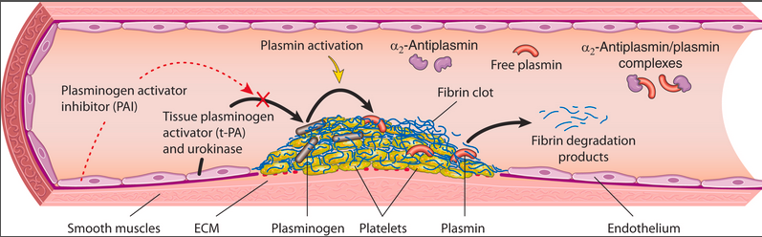
Fibrinolytic System* Activation and Inhibition from Previous Overview
Activation:
Platelet-fibrin clots form at sites of EC injury, and circulating plasminogen binds to the clots.
Activated ECs secrete tissue plasminogen activator (tPA).
tPA binds to clots, cleaves plasminogen to plasmin, and degrades the clot.
Inhibition:
tPA is inhibited by activated plasminogen activator inhibitor (PAI), which is synthesized by quiescent and activated ECs.
Free plasmin is also inhibited by circulating inhibitors
Robbins Basic Pathology, 2023 – Figure 3.10

Slide 46
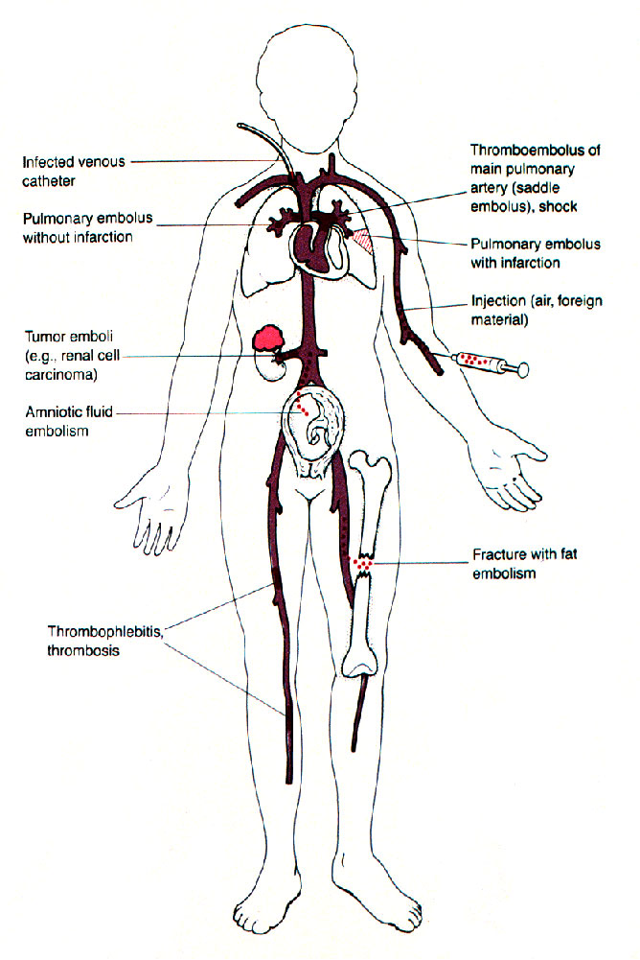
Not all Emboli are Thromboemboli
However, thrombi often form near the site of embolic occlusion

Slide 47
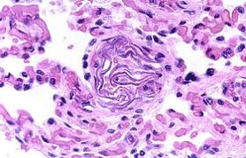
Amniotic Fluid Embolus in Lung
Fetal squamous cells in small artery
H&E
Notes:
A small pulmonary artery is occluded by superficial squamous cells derived from fetal skin. The amniotic fluid cells entered maternal during a complicated delivery.

Slide 48
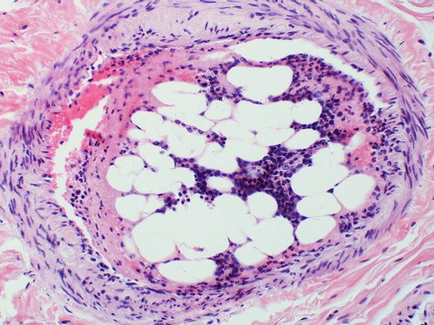
Bone Marrow Embolus
Fat and hematopoietic cells in vein
H&E
Notes:
Here bone marrow entered the venous system after a traumatic bone fracture. These can sometimes result from vigorous cardiopulmonary resuscitation (CPR).

Slide 49
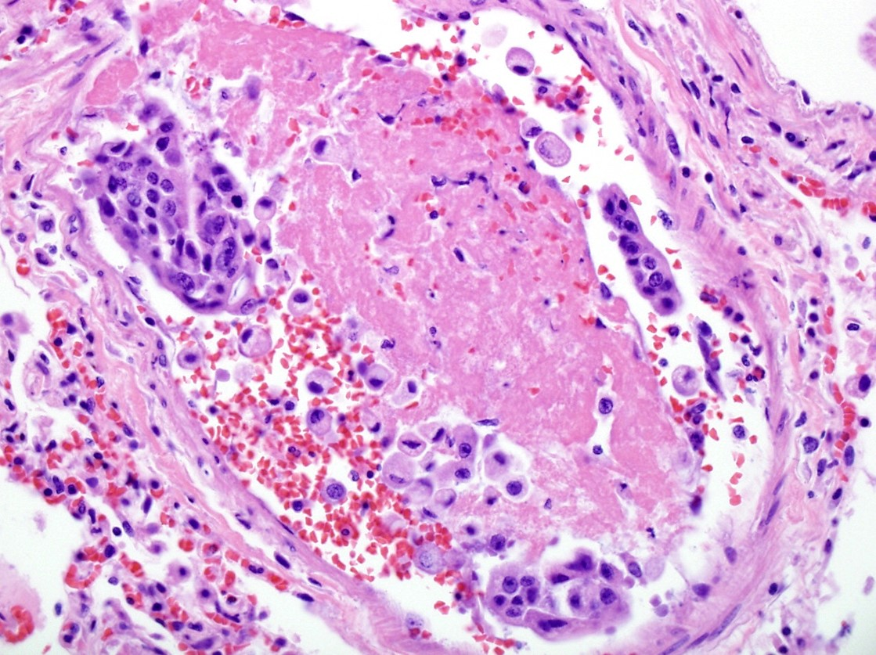
Tumor Embolus of Lung
Cancer
Thrombus
Cancer
H&E
Notes:
Carcinoma cells were delivered to the lung after venous invasion.

Slide 50
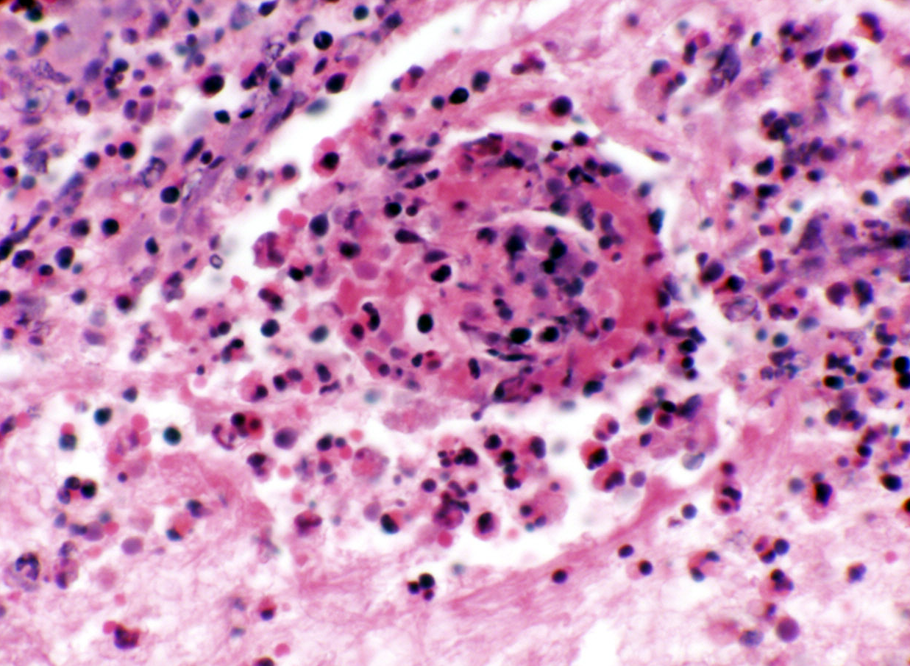
“Septic Embolus” in Septic Infarct
Vascular necrosis with PMNs
H&E
Notes:
The patient had a widespread bacterial infection with sepsis (bacteria in the blood). The pulmonary vessel is occluded by thrombus that also show numerous PMNs (polymorphonuclear leukocytes or neutrophils). Septic infarcts can show coagulation necrosis as a consequence of ischemia. However, areas of liquefactive necrosis could also be seen if there is tissue dissolution secondary to the release of neutrophil and/or microbial proteases.

Slide 51
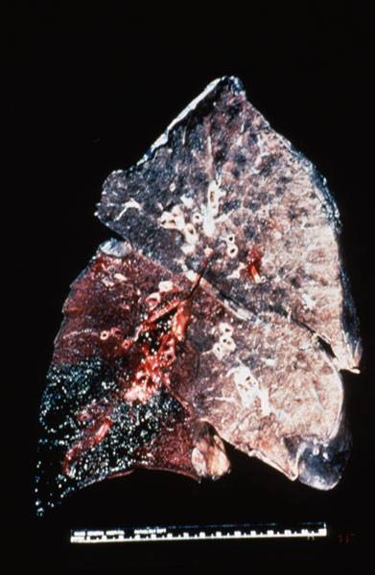
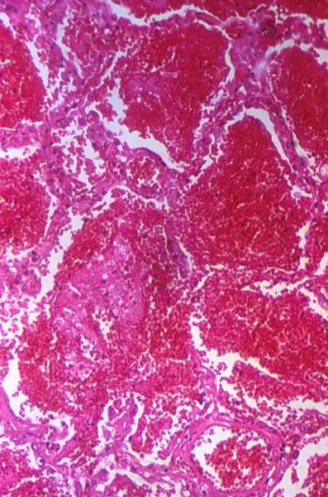
Pulmonary Infarct What type of infarct?
Airspace
Gross
H&E
Airspaces filled with blood
Notes:
The gross shows a hemorrhagic infarct in the lower lobe of lung. Microscopic examination show death of cells within the involved gas exchange tissue with blood in the airspaces. Red infarcts are characteristic in this soft, spongy tissue with a dual pulmonary and systemic blood supply. For this module you are not expected to recognize the histology of a pulmonary infarct.

Slide 52
Potential Complications of DIC
Bleeding (majority)
Renal dysfunction (25%)
Hepatic dysfunction (15-25%)
Respiratory dysfunction (15-25%)
Shock (15-25%)
CNS dysfunction
Multi-organ system failure, often lethal depending on etiology

Slide 53
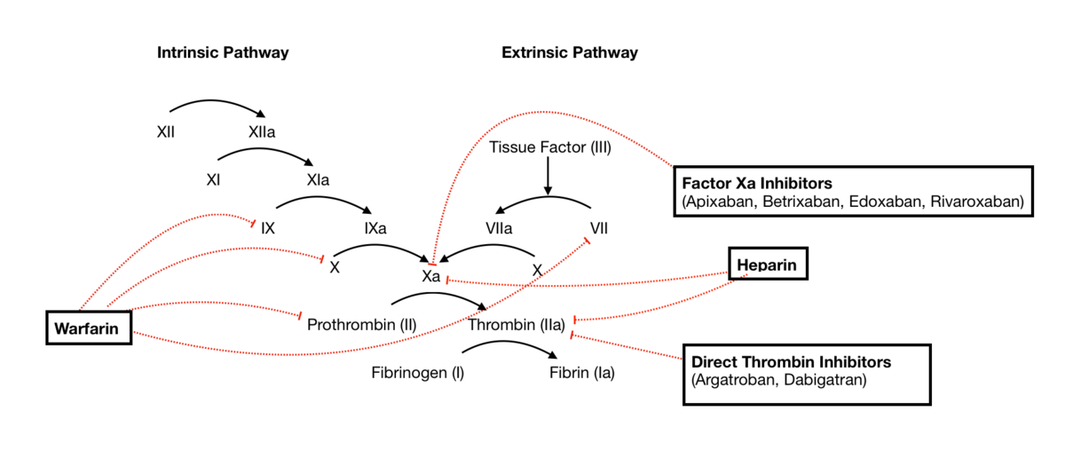
Clinical Anticoagulants
*
Factor Xa Inhibitors
(Apixaban, Betrixaban, Edoxaban, Rivaroxaban)
*
Factor Xa Inhibitors
*
*
*
*
LMW Heparin
*
Unfractionated Heparin
*
*
Unfractionated Heparin
*
Factor IIa Inhibitors
(Argatroban, Dabigatran)
Warfarin
IIa Inhibitors
Notes:
Warfarin (Coumadin) inhibits gamma-carboxylation of the vitamin K dependent factors. Remember: 2+ 7 = 9 not 10. However, all factors are not equally effected. Factors with a shorter half-life in the circulation can be more sensitive and Factor VII can be preferentially inhibited.
Heparin is more rapid acting than Warfarin. Low molecular weight heparin (LMWH) is increasingly preferred used over the unfractionated heparin, which is heterogeneous and includes higher molecular weight forms. LMWH is more specific for factor Xa; it is also more predictable with less risk of complications. Depending on the clinical context, it may not require monitoring.
Endogenous heparin-like molecules bind to and activate anti-thrombin III. Activated antithrombin III preferentially inhibits thrombin and factor X, with lesser effects on other serine proteases in the intrinsic pathway. Unfractionated heparin has similar effects.
Factor VII is a serine protease but is only slowly inactivated by AT, even in the presence of heparin, and only when complexed with tissue factor. However, there are heparin inhibitors, e.g. polybrene, in the PT assay and there is no prolongation unless heparin levels are very high.
IIa and Xa inhibitors are more specific than heparins, are more rapid onset, and require no monitoring.

